Slide 1
Cybersecurity
Logic Bombs

Slide 2
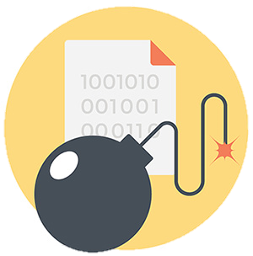
Logic Bomb
Waits for a predefined event
Often left by someone with grudge
Timebomb
Time or date
User event
Logic bomb
Difficult to identify
Difficult to recover if it goes off

Slide 3
Real-world logic bombs
March 19, 2013, South Korea
Email with malicious attachment sent to South Korean organizations
Posed as bank email
Trojan installs malware
March 20, 2013, 2pm local
Malware logic-bomb activates
Storage and master boot record (MBR) delected, system reboots
Boot device not found. Please install an operating system on your hard disk.

Slide 4
Real-world logic bombs
December 17, 2016, 11:53pm
Kiev, Ukraine, high voltage substation
Logic bomb begins disabling electrical circuits
Malware mapped out the control network
Began disabling power at a predetermined time
Customized for SCADA networks
Supervisory Control and Data Acquisistion

Slide 5

Preventing a logic bomb
Hard to spot
Each is scenario is unique
No defined signature
Process and procedures
Electronic monitoring
Alert on changes to critical data
Host-based IDS
Insider information
Knows where to hit, when most damaging, possibly how not to get caught
Regular scanning/auditing
An malicious administrator can circumvent these approaches
Backups and snapshots

